Slide 1
Module 05: Monitor & Back Up Azure Resources

Slide 2
Lesson 1 – Monitoring the Resources

Slide 3
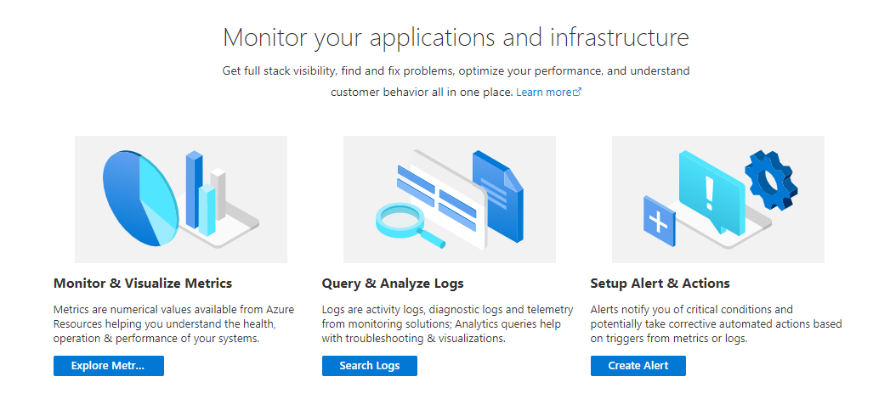
Configure and Interpret Metrics
In Azure, we can use 3 tools for monitoring to stay aware of what’s happening with our resources:
Monitor and Visualize Metrics
Query and Analyze Logs
Set Up Alerts and Actions

Slide 4

Azure Monitor Service
Azure Monitor
Insights
Sources of Monitoring Data
Azure Subscription
Azure Resources
Azure Tenant
Operating System
Application
Custom Sources
Metrics
Visualize
Analyze
Logs
Respond
Alerts
Integrate

Slide 5
Different Tiers for Data Collection
Application Monitoring Data
Guest OS Monitoring Data
Azure Resource Monitoring Data
Azure Subscription Monitoring Data
Azure Tenant Monitoring Data

Slide 6
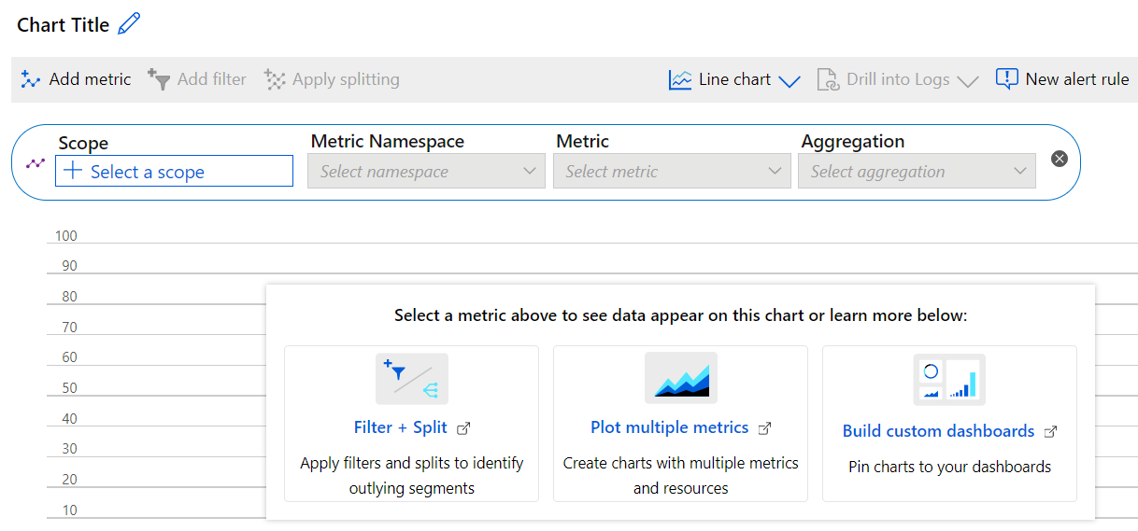
Metrics
Numerical values that describe some aspect of a system at a particular point in time.

Slide 7

Logs
Log data collected by Azure Monitor is stored in Log Analytics.
This includes rich query language to quickly retrieve, consolidate, and analyze collected data.
Azure Monitor uses a version of the Data Explorer query language that is suitable for simple log queries.
This includes advanced functionality such as aggregations, joins, and smart analytics.
Users can quickly learn the query language using multiple lessons.

Slide 8
Data Types
Application Monitoring Data: Data about the performance and functionality of the code users have written – regardless of its platform.
Guest OS Monitoring Data: Data about the operating system on which the user’s application is running. This could be running in Azure, another cloud, or on-premises.
Azure Resource Monitoring Data: Data about the operation of an Azure resource.
Azure Subscription Monitoring Data: Data about the operation and management of an Azure subscription, as well as data about the health and operation of Azure itself.
Azure Tenant Monitoring Data: Data about the operation of tenant-level Azure services, such as Azure Active Directory.

Slide 9
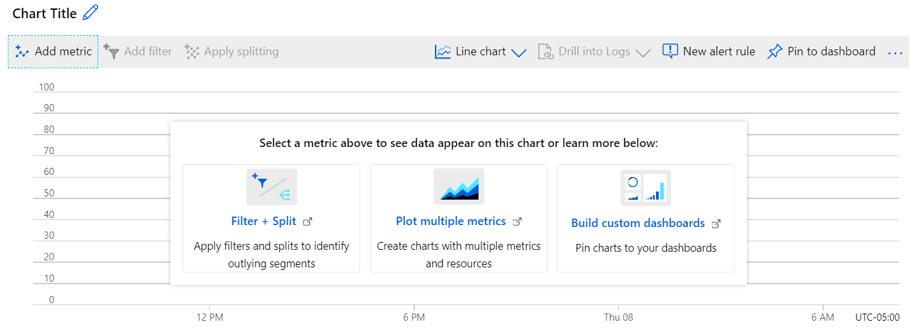
Working with Alerts
All data that Azure Monitor collects fits into one of two fundamental types: Metrics or Logs
Possible uses of Metric Data in Azure Monitor:
Analyze
Visualize
Alert
Automate (Auto Scale)
Export
Retrieve
Archive
Possible uses of Logs in Azure Monitor:
Analyze (Query)
Visualize
Alert
Export
Retrieve

Slide 10
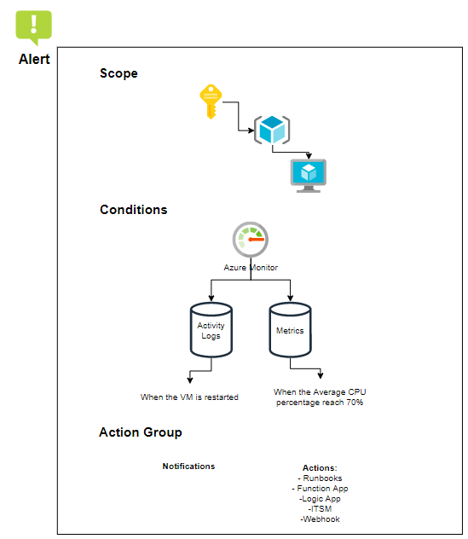
Working with Alerts
With the Azure Monitor service, alerts need to be configured to set the conditions to notify and/or trigger an action response.
Notifications and actions can be configured with an alert by configuring an action group.
A severity level defines the critical level of the condition.

Slide 11
View Alerts
Alert Rule Attributes
Target Resource: Defines the scope and signals available for alerting. A target can be any Azure resource.
Signal: Emitted by the target resource.
Metric
Activity log
Application Insights
Log
Criteria: A combination of signal and logic applied on a target resource. Examples:
Percentage CPU > 70%
Server Response Time > 4 ms
Result Count of a Log Query > 100
Alert Name: A specific name for the alert rule configured by the user.
Alert Description: A description for the alert rule configured by the user.
Severity: The severity of the alert after the criteria specified in the alert rule is met. Severity can range from 0 to 4.
Sev 0 = Critical
Sev 1 = Error
Sev 2 = Warning
Sev 3 = Informational
Sev 4 = Verbose
Action: A specific action taken when the alert is fired.

Slide 12
Creating Actions Groups
An action group is a collection of notification preferences defined by the owner of an Azure subscription:
Automation Runbook – the ability to define, build, orchestrate, manage, and report on workflows that support system and network operational processes.
Azure Function – is a serverless compute service that lets users run event-triggered code.
Email Azure Resource Manager Role – send an email to the members of the subscription's role.
Email/SMS/Push/Voice – specify any email, SMS, push, or voice actions.
ITSM – connect Azure and a supported IT Service Management (ITSM) product/service.
Logic App – connect user business-critical apps and services by automating their workflows.
Webhook – an HTTP endpoint that allows external applications to communicate with the user’s system.

Slide 13
Diagnostic Logging and Log Retention
Application
Resource
Azure Monitor Diagnostic Logs:
Tenant Logs: Logs from tenant-level services that exist outside of an Azure subscription.
Resource Logs: Logs from Azure services that deploy resources within an Azure subscription.
Application Logs
Diagnostic Logs
Diagnostic Logs
Guest OS
Host VM
Azure Infrastructure
Activity
Logs
Activity
Logs
Azure Infrastructure
Compute Resource Only
Non-Compute Resource Only

Slide 14
Diagnostic Logging and Log Retention
Example of what can be done with Diagnostic Logs:
Export
Azure Monitor Logs
Event Hub
Azure Storage
Resource
Configure
Azure Portal
PowerShell
Command Line Interface
REST API
Diagnostic Logs
Diagnostic Settings
Azure Infrastructure
Activity
Logs

Slide 15
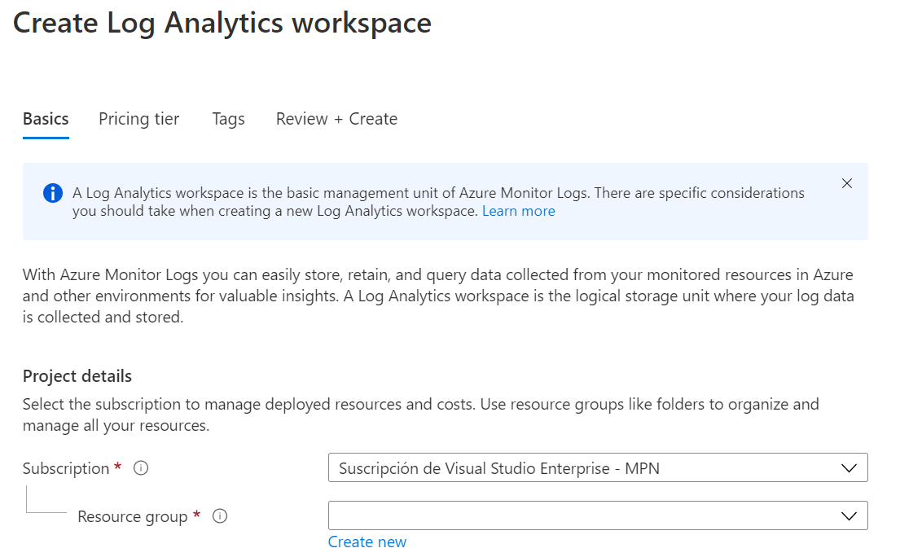
Implementing Log Analytics Workspace
To get started with Log Analytics, users need to add a workspace.
Provide a name for the new Log Analytics Workspace.
Select a Subscription from the drop-down list.
For Resource Group, select an existing resource group that contains one or more Azure Virtual Machines.
Select the location that the user VMs are deployed to.
The workspace will automatically use the Per GB pricing plan.

Slide 16
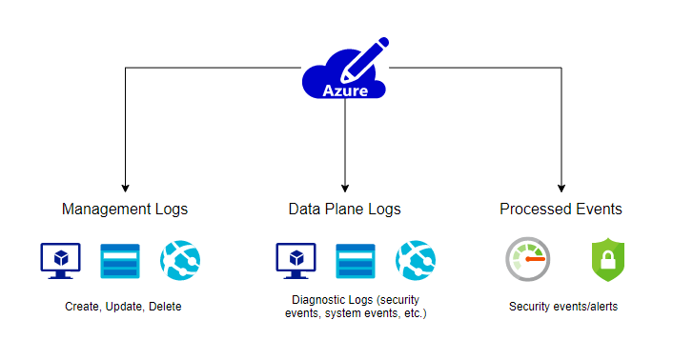
Security Logs with Azure Monitor
Management logs store, create, update, and delete actions.
Data plan logs store diagnostics about different resource types (such as system or security events from VMs).
Processed events store alert information from Azure Monitor, Security Center, or Azure Sentinel.

Slide 17
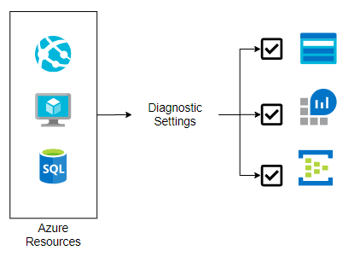
Diagnostic Logging and Log Retention
Many Azure resources can generate diagnostic logs (optional).
A destination is required for those logs for log retention.
Storage Account, Log Analytics Workspace (for the analytics service), and Event Hub (for streaming logs outside Azure)
Users can use the destination resources configuration to set the desired log retention policy by using any of the destinations.

Slide 18
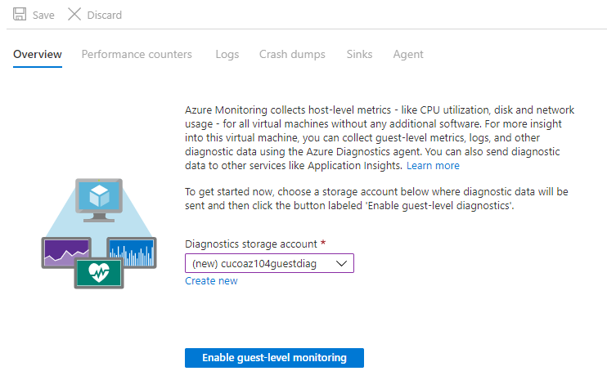
Configure Diagnostics Settings
Azure Monitoring collects host-level metrics - like CPU utilization, disk and network usage - for all Virtual Machines without any additional software.
Users can collect guest-level metrics, logs, and other diagnostic data by using the Azure Diagnostics Agent to gain more insight into this Virtual Machine.
Users can also send diagnostic data to other services like Application Insights.

Slide 19
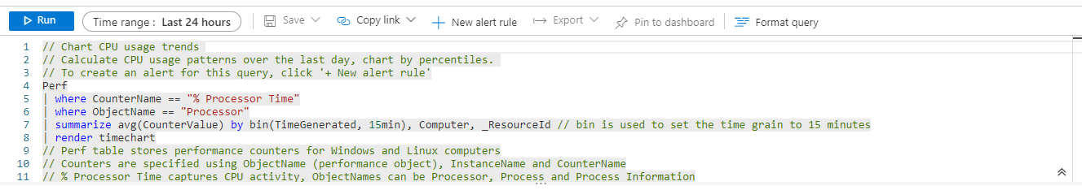
Query and Analyze Logs
Log Analytics Querying
Provides a query syntax to quickly retrieve and consolidate data in the repository.
Create and save Log Searches to directly analyze data in the portal or have log searches run automatically to create an alert if the results of the query indicate an important condition.

Slide 20
Lesson 2 – Back Up & Recovery

Slide 21
Back Up and Recovery
Azure Backup is the Azure-based service users can use to back up (or protect) and restore their data in the Microsoft cloud.
Azure Backup replaces existing on-premises or off-site backup solution with a cloud-based solution that is reliable, secure, and cost-effective.
Azure Backup offers multiple components that users can download and deploy on the appropriate computer, server, or in the cloud.
The component, or agent, that the users deploy depends on what they want to protect.
All Azure Backup components (no matter whether users are protecting data on-premises or in the cloud) can be used to back up data to a Recovery Services Vault in Azure.

Slide 22
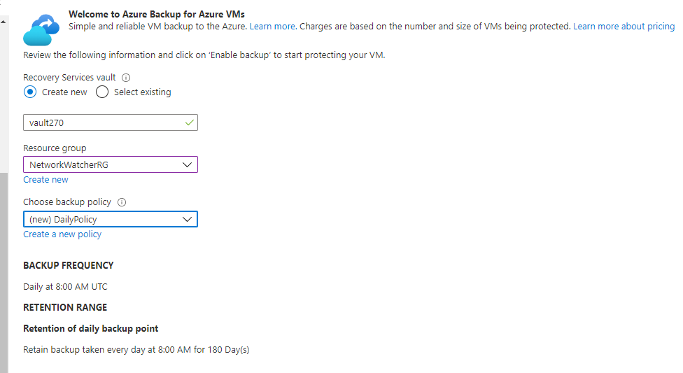
Back Up and Recovery
Benefits
Offload On-Premises Backup
Back Up Azure IaaS VMs
Get Unlimited Data Transfer
Keep Data Secure
Get App-Consistent Backups
Retain Short and Long-Term Data
Automatic Storage Management
Multiple Storage Options

Slide 23
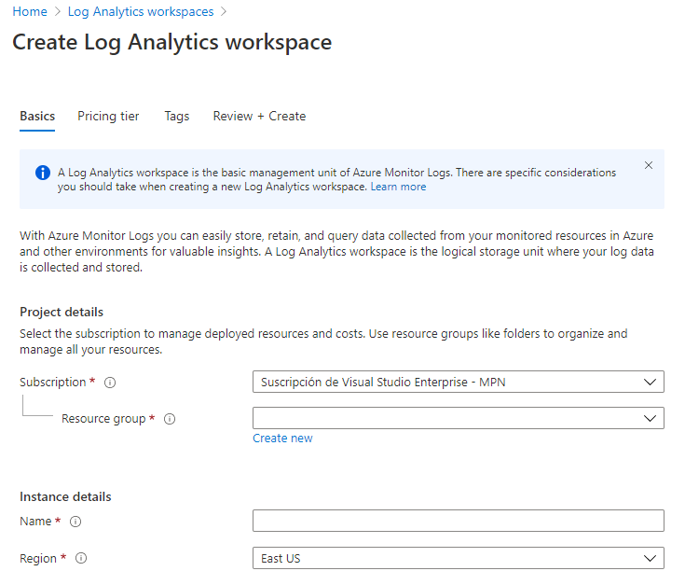
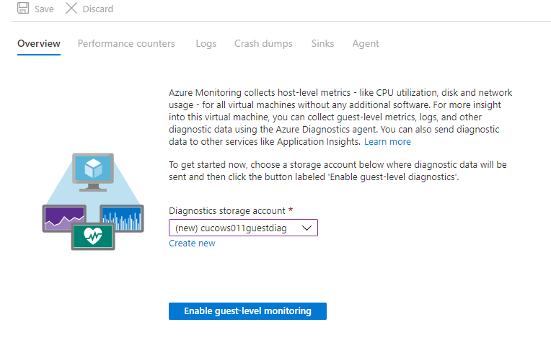
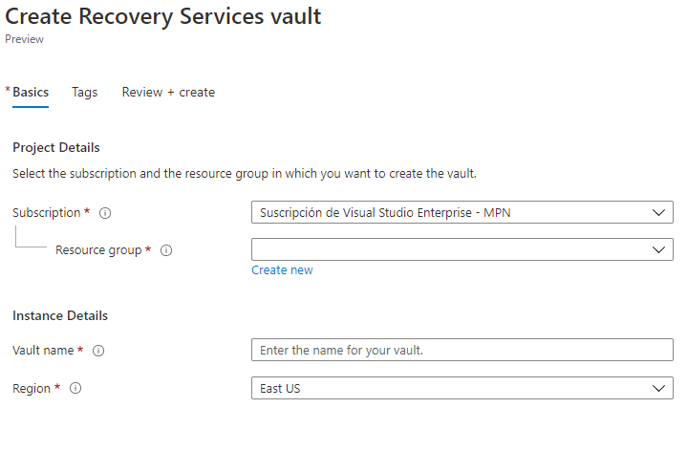
Configure Backup Reports
Azure Backup provides a reporting solution that uses Azure Monitor Logs and Azure Workbooks. These resources provide rich insights on backups across the entire backup estate.
1. Create a Log Analytics Workspace or use an Existing One
2. Configure Diagnostics Settings for Vaults
3. View Reports in the Azure Portal

Slide 24
Azure Backup Service
Elements that can be Backed Up:
Azure Database for PostgreSQL Servers (preview):
Back Up Azure PostgreSQL Databases and Retain the Backups for Up to 10 Years
On-Premises:
Back Up Files, Folders, and System State
On-Premises VMs (Hyper-V and VMware)
Other On-Premises Workloads
SQL Server in Azure VMs:
Back Up SQL Server Databases Running on Azure VMs
Azure VMs:
Back Up Entire Windows/Linux VMs (back up files, folders, and system state)
Azure File Shares:
Back Up Azure File Shares to a Storage Account
SAP HANA databases in Azure VMs:
Backup SAP HANA Databases Running on Azure VMs

Slide 25
Recovery Service Vault
Recovery Services Vault: a storage entity in Azure that houses data. This is typically copies of data, or configuration information for Virtual Machines (VMs), workloads, servers, or workstations.
Recovery Services Vaults: hold backup data for various Azure services such as IaaS VMs (Linux or Windows) and Azure SQL databases.
Recovery Services Vaults: support System Center DPM, Windows Server, Azure Backup Server, and more.
Recovery Services Vaults: make it easy to organize user backup data while minimizing management overhead.

Slide 26
Backup Options
Users can protect their data by taking backups at regular intervals. There are several backup options available for VMs, depending on the user use-case.
Azure Backup
For backing up Azure VMs running production workloads – use Azure Backup.
Azure Backup supports application-consistent backups for both Windows and Linux VMs.
Azure Site Recovery
Azure Site Recovery protects user VMs from a major disaster scenario when a whole region experiences an outage due to major natural disaster or widespread service interruption.
Managed Disk Snapshots
In development and test environments, snapshots provide a quick and simple option for backing up VMs that use Managed Disks.

Slide 27
Azure Site Recovery
Site Recovery helps ensure business continuity by keeping business apps and workloads running during outages.
Site Recovery replicates workloads running on physical and Virtual Machines (VMs) from a primary site to a secondary location.
When an outage occurs at the user’s primary site, it fails over to a secondary location, and apps can be accessed from there.
After the primary location is running again, one can fail back to it.

Slide 28
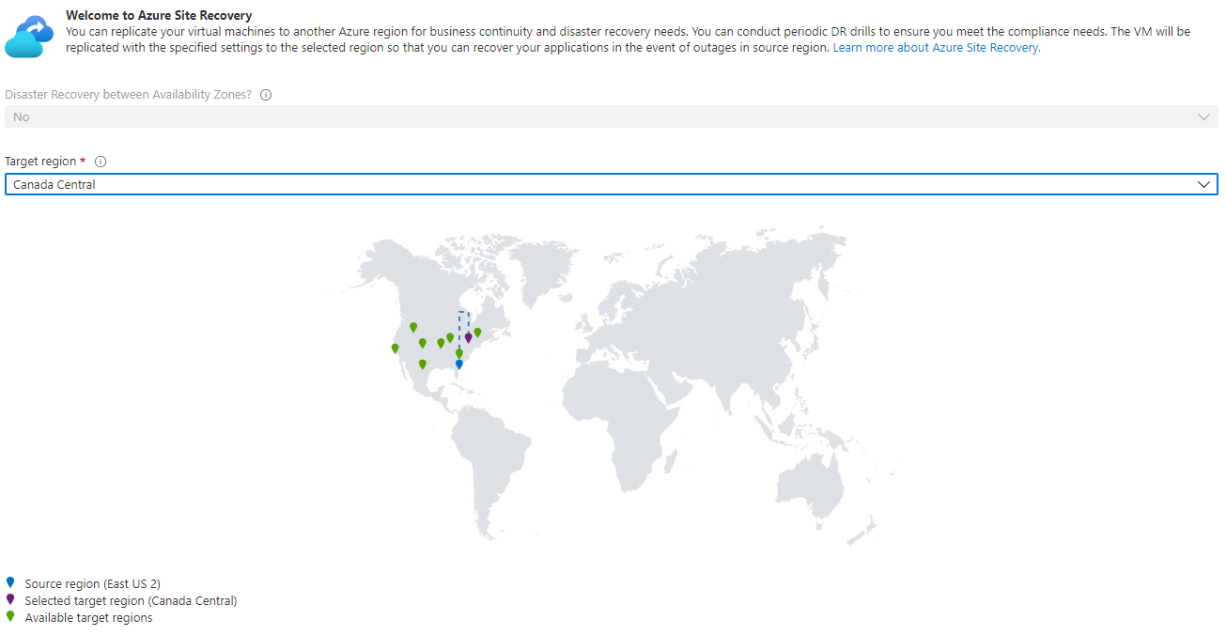
Azure Site Recovery
Users can replicate their Virtual Machines to another Azure region for business continuity and disaster recovery needs.
Users can conduct periodic DR drills to ensure they meet the compliance needs.
The VM will be replicated with the specified settings to the selected region so that users can recover their applications in the event of outages in the source region.

Slide 29
Azure Site Recovery
Replication Scenarios:
Replicate Azure VMs from one Azure region to another.
Replicate on-premises VMware VMs, Hyper-V VMs, physical servers (Windows and Linux), and Azure Stack VMs to Azure.
Replicate AWS Windows instances to Azure.
Replicate on-premises VMware VMs, Hyper-V VMs managed by System Center VMM, and physical servers to a secondary site.

